Slide 1
ABORDAGEM DESIGN SCIENCE
Prof. José Osvaldo De Sordi
2011

Slide 2
Críticas à Pesquisa na Área de Administração
Mainstream research on organization and management is largely modeled after the natural sciences and the humanities. It aims at understanding social systems and, as such, has produced a vast knowledge base. However, this knowledge base has been criticized as fragmented and lacking relevance for practice.
Fonte: Van Aken e Romme (2009, p.5)
[…] has been criticized as having too little relevance for practice (see e.g., Beyer and Trice, 1982; Daft and Lewin, 1990; Hambrick, 1994; Tranfield and Starkey, 1998; Rynes et al., 2001) and for being too fragmented (see e.g., Koontz, 1980; Whitley, 1984; Pfeffer 1993; Van Maanen 1995; Whitley 2000).
Fonte: Van Aken e Romme (2009, p.5)

Slide 3
Críticas à Pesquisa na Área de Administração
Ciências Sociais Aplicada
... aplicada na sociedade, no caso da administração, na sociedade organizada na forma de Empresas
Most disciplines within the social sciences have in the past few decades been pre-occupied with the epistemological debate between the quantitative, neo-positivistic science and the qualitative, interpretative humanities approach. This debate appears to have turned attention away from the important issue of research objectives and our commitments as scholars (Wicks and Freeman, 1998). As a result, design thinking is largely absent in the social sciences.
Fonte: Van Aken e Romme (2009, p.5)

Slide 4
Críticas à Pesquisa na Área de Administração
Ciências Sociais Aplicada
... aplicada na sociedade, no caso da administração, na sociedade organizada na forma de Empresas
Pesquisadores típicos da área de gestão passaram as últimas décadas reocupados em demonstrar aos seus pares de outras áreas, que pesquisar administração também é fazer ciência, que também trabalham com o rigor científico (debates epistemológicos infindáveis), que acabaram esquecendo do próprio objeto da pesquisa: a organização.

Slide 5
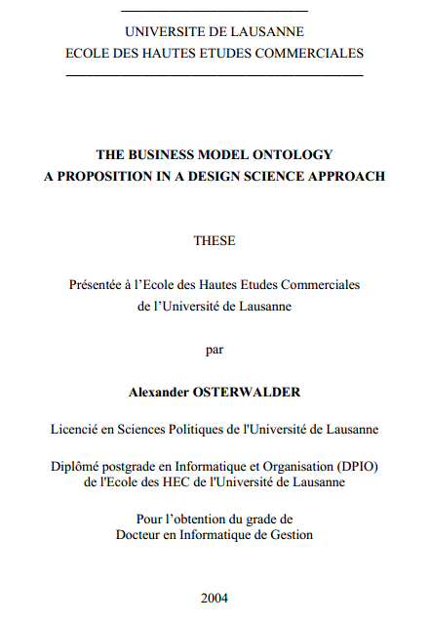
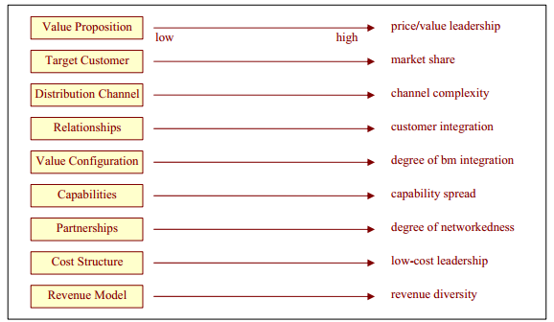
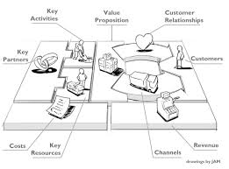
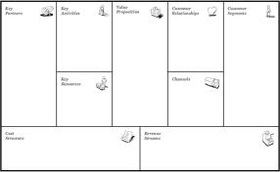
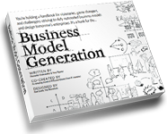

Um exemplo popular de Design Science

Slide 6
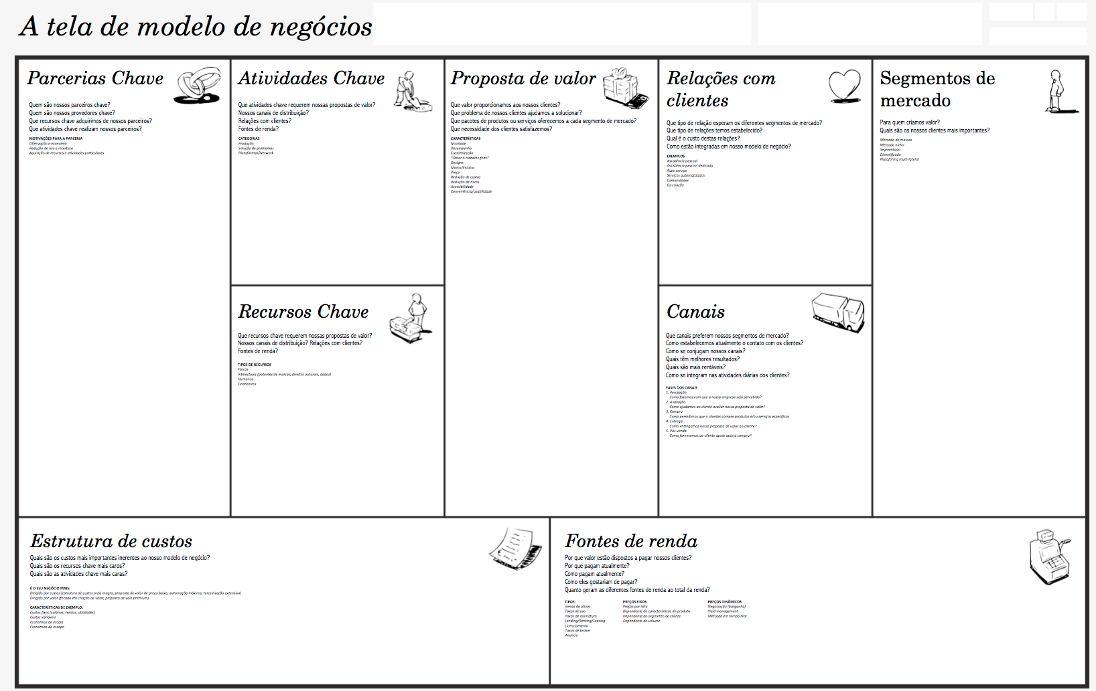
Business Model Canvas

Slide 7
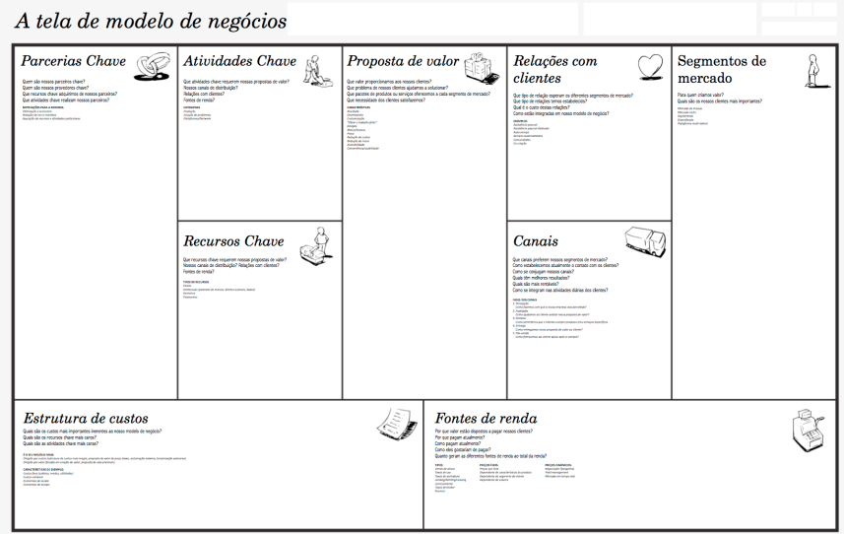
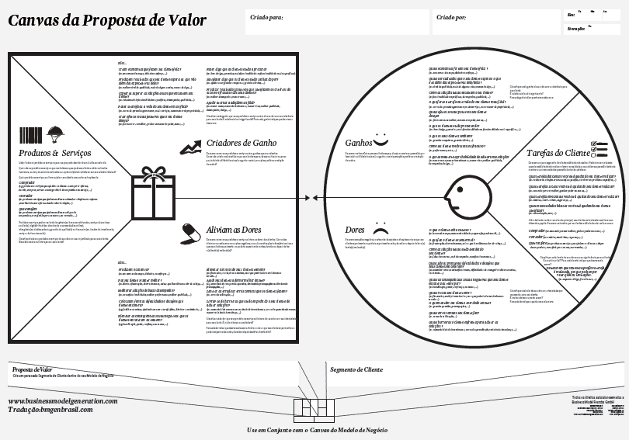
Value Proposition Canvas

Slide 8
Características da Abordagem Design Science
research questions are driven by field problems (as opposed to pure knowledge problems); PRAGMÁTICA
there is an emphasis on solution-oriented knowledge, linking interventions or systems to outcomes, as the key to solve field problems; INTERVENCIONISTA
the justification of research products is largely based on pragmatic validity (do the actions, based on this knowledge indeed produce the intended outcomes?). COMPROVADA PELOS PRATICANTES
Fonte: Van Aken e Romme (2009, p.5)

Slide 9
Design Science e os Artefatos
The behavioral-science paradigm seeks to develop and verify theories that explain or predict human or organizational behavior. The design-science paradigm seeks to extend the boundaries of human and organizational capabilities by creating new and innovative artifacts.
Fonte: Hevner et al (2004, p.75)

Slide 10
Artefato
No senso-comum:
Algo criado pelo homem com alguma finalidade prática
Cientificamente:
Produto de caráter artificial, como os obtidos em testes científicos, com concepção provocada por algum agente, normalmente humano
[…] organizations are also artifacts, shaped through design-based interventions by their founders and other change agents, as well as action systems created and sustained by their stakeholders to combine and coordinate actions to further common goals. Therefore, it is important to complement research into organizations-as-natural systems with studies of organizations-as-artifacts.
Fonte: Van Aken e Romme (2009, p.6)

Slide 11
Alegação do Conhecimento Pragmática
It is fundamentally a problem-solving paradigm. It seeks to create innovations that define the ideas, practices, technical capabilities, and products through which the analysis, design, implementation, management, and use of information systems can be effectively and efficiently accomplished (Denning 1997; Tsichritzis 1998). Such artifacts are not exempt from natural laws or behavioral theories. To the contrary, their creation relies on existing kernel theories that are applied, tested, modified, and extended through the experience, creativity, intuition, and problem solving capabilities of the researcher (Markus et al. 2002; Walls et al. 1992).
Fonte: Hevner et al (2004, p.76)

Slide 12
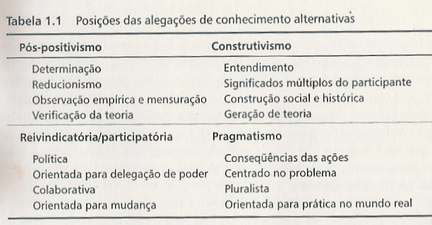
Taxionomia para Alegações do Conhecimento
Fonte: Creswell (2007, p.24)

Slide 13
Centrada na Utilidade na Efetividade
The goal of behavioral-science research is truth. The goal of design-science research is utility.
Fonte: Hevner et al (2004, p.80)
The behavioral-science paradigm seeks to find "what is true." In contrast, the design-science paradigm seeks to create "what is effective.“
Fonte: Hevner et al (2004, p.98)

Slide 14
Centrada na Utilidade na Efetividade
The fundamental questions for design-science research are, "What utility does the new artifact provide?" and "What demonstrates that utility?" Evidence must be presented to address these two questions. That is the essence of design science.

Slide 15
Pré-requisito do Artefato: Utilidade
Contribution arises from utility. If existing artifacts are adequate, then design-science research that creates a new artifact is unnecessary (it is irrelevant). If the new artifact does not map adequately to the real world (rigor), it cannot provide utility. If the artifact does not solve the problem (search, implementability), it has no utility. If utility is not demonstrated (evaluation), then there is no basis upon which to accept the claims that it provides any contribution (contribution). Furthermore, if the problem, the artifact, and its utility are not presented in a manner such that the implications for research and practice are clear, then publication in the IS literature is not appropriate (communication).
Fonte: Hevner et al (2004, p.91)

Slide 16
Pré-requisito do Artefato: Genérico para um Tipo de Problema
‘‘General’’ here means that it is not a specific solution for a specific situation, but a general solution for a type of problem. (On the other hand, a design proposition is a mid-range theory, whose validity is limited to a certain application domain.)
Fonte: Van Aken e Romme (2009, p.8)

Slide 17
Pré-requisito do Artefato: Intervencionista
Formulated in another way, the logic of the design
proposition is, ‘‘if you want to achieve Y in situation
Z, then apply intervention X.’’ The core of the
design proposition is X, a general solution concept for
a certain type of field problem. The remainder of the
Proposition is a kind of user instruction connecting
the solution concept with the field problem,
including indications and contra-indications, that
is, knowledge on when to use the solution concept
and when not to. The solution concept can be an
act, a sequence of acts, but also some process or
system.
Fonte: Van Aken e Romme (2009, p.8)

Slide 18
Pré-requisito do Artefato: Intervencionista
Variáveis
Intervenientes
Teoria da Justiça Organizacional
  - justiça atributiva
  - justiça processual
  - justiça interacional
Z
Variáveis
Independentes
Dependendo de:
  - sexo
  - faixa etária
  - etnia
  - religião
  - ...
X
Motivação dos Funcionários
  produtividade
  satisfação
  - absenteísmo
  - rotatividade
Variáveis
Dependentes
Y

Slide 19
Pré-requisito do Artefato: Intervencionista
Variáveis
Intervenientes
Realidade X da Empresa
Z
Variáveis
Independentes
Aplicação
do
ARTEFATO
X
Novo estado Y da Empresa
Variáveis
Dependentes
Y

Slide 20
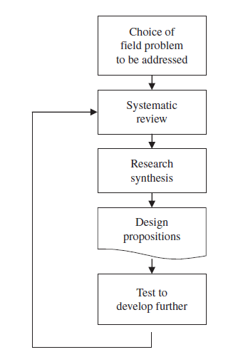
O Ciclo da Pesquisa na Abordagem Design Science
Fonte: Van Aken e Romme (2009, p.10)

Slide 21
Revisão Sistemática da Literatura
As in evidence-based medicine, problem-solving in these projects is based on a (formal or sometimes less formal) systematic review of the literature on their type of field problem, followed by a synthesis into a number of alternative solution concepts. In the review, students typically use academic literature (typically based on the explanatory paradigm, and therefore rich in evidence but poor in solutions) as well as ‘‘practice-based literature’’ (almost always informally based on the design paradigm that is rich in practical solutions, but currently also poor in evidence).
Fonte: Van Aken e Romme (2009, p.8)

Slide 22
Dados Empíricos para Validação do Artefato
Gerados pela aplicação, pelo uso, do próprio artefato proposto.
Para que não haja viés de laboratório/pesquisador, que o artefato seja testado pelos próprios praticantes típicos.

Slide 23
Teste do Artefato Proposto
Mesmo rigor das demais abordagens científicas:
Testing a design proposition to find out whether it works can be done by means of statistical tests, clinical case studies, pragmatic experimentation and action research (e.g., Argyris et al., 1985; Schein, 1987; MacLean et al., 2002).
Fonte: Van Aken e Romme (2009, p.9)

Slide 24
Formato do Artefato
Formulated in another way, the logic of the design
proposition is, ‘‘if you want to achieve Y in situation
Z, then apply intervention X.’’ The core of the
design proposition is X, a general solution concept for
a certain type of field problem. The remainder of the
Proposition is a kind of user instruction connecting
the solution concept with the field problem,
including indications and contra-indications, that
is, knowledge on when to use the solution concept
and when not to. The solution concept can be an
act, a sequence of acts, but also some process or
system.
Fonte: Van Aken e Romme (2009, p.8)

Slide 25
Exemplos de Artefatos em Sistemas de Informação
Constructs provide the language in which problems and solutions are defined and communicated (Schon 1983).
Models use constructs to represent a real world situation-the design problem and its solution space (Simon 1996). Models aid problem and solution understanding and frequently represent the connection between problem and solution components enabling exploration of the effects of design decisions and changes in the real world.
Methods define processes. They provide guidance on how to solve problems, that is, how to search the solution space. These can range from formal, mathematical algorithms that explicitly define the search process to informal, textual descriptions of "best practice" approaches, or some combination.
Instantiations show that constructs, models, or methods can be implemented in a working system. They demonstrate feasibility, enabling concrete assessment of an artifact's suitability to its intended purpose. They also enable researchers to learn about the real world, how the artifact affects it, and how users appropriate it.

Slide 26
Exemplos de Artefatos em Sistemas de Informação
IT artifacts are broadly defined as
constructs (vocabulary and symbols),
models (abstractions and representations),
methods (algorithms and practices), and
instantiations (implemented and prototype systems).
Fonte: Hevner et al (2004, p.77, grifo nosso)

Slide 27
Exemplos de Artefatos na Administração
Rozemeijer (2000), developing solution concepts for organizing the purchasing function of an industrial company; Andriessen (2003), developing solution concepts for the valuation of the intangible assets of an organization and Romme and Endenburg (2006), developing solution concepts for re-engineering organizations around the notion of circularity.
Fonte: Van Aken e Romme (2009, p.10)

Slide 28
Exemplos de Artefatos na Administração
Aplicável a métodos e processos (intervenções):
Van Aken (2004, 2005) has addressed the problem of what prescriptive management theory might look like and advances the idea of "technological rules," which take the form: "If you want to achieve Y in situation Z, then something like action X will help" (2004, p. 227). Although of interest for our present endeavor, the field of management is less concerned with the design of products (as in database architecture) than with methods or processes (interventions), so has some limitations in being transferred to IS, where both are of interest.
Fonte: Gregor e Jones (2007, p.319)

Slide 29
Análise de Artigos que Utilizam Abordagem DS
Para cada um dos quatro artigos entregues identifique:
Área da gestão que se beneficia do artefato (gestão de pessoas, gestão da produção, gestão das finanças, gestão do capital intelectual, ...)
Artefato (descrição do que é/entidades constituintes)
Conceito explorado pelo artefato (finalidade/benefícios)
Público-alvo (profissionais usuários)
Relevância

Slide 30
Análise de Artigos que Utilizam Abordagem DS
Para cada um dos quatro artigos entregues identifique:
Área da gestão que se beneficia do artefato (gestão de pessoas, gestão da produção, gestão das finanças, gestão do capital intelectual, ...)
Artefato (descrição do que é/entidades constituintes)
Conceito explorado pelo artefato (finalidade/benefícios)
Público-alvo (profissionais usuários)
Relevância
Respostas localizadas nas páginas 28, 29 e 30 do artigo ...

Slide 31
Sete Diretrizes para Pesquisa Design Science
o objeto de estudo da pesquisa como artefato;
artefato associado a problemas relevantes ao negócio;
rigor na demonstração da utilidade, qualidade e eficácia do artefato projetado;
geração de contribuições significativas para área de aplicação do artefato;
método rigoroso empregado na construção e validação do artefato;
emprego de recursos para alcance dos fins com respeito às leis do ambiente pertinente ao problema;
resultados da pesquisa eficazmente expostos aos públicos tecnológicos e de negócios pertinentes ao protótipo. Fonte: Hevner et al (2004)

Slide 32
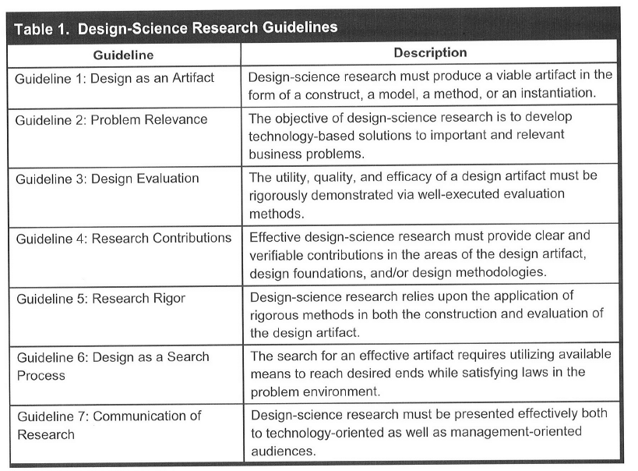

Sete Diretrizes para Pesquisa Design Science
Fonte: Hevner et al (2004, p.83)

Slide 33
Diretriz 2 – Relevância do Problema
A relevância de qualquer esforço em Design Science refere-se a uma comunidade constituinte (praticantes).
Fonte: Hevner et al (2004, p.85)
[Design Science] it is not a specific solution for a specific situation, but a general solution for a type of problem.
Formulated in another way, the logic of the design proposition is, "if you want to achieve Y in situation Z, then apply intervention X." The core of the design proposition is X, a general solution concept for a certain type of field problem.
Fonte: Van Aken e Romme (2009, p.8)

Slide 34
Diretriz 2 – Relevância do Problema
Pontos importantes:
Não pode ser um problema específico de uma empresa ou profissional, tem de ser reconhecido por uma comunidade de praticantes
Trata-se do conceito de solução para determinado tipo de problema reconhecido pela comunidade de praticantes

Slide 35
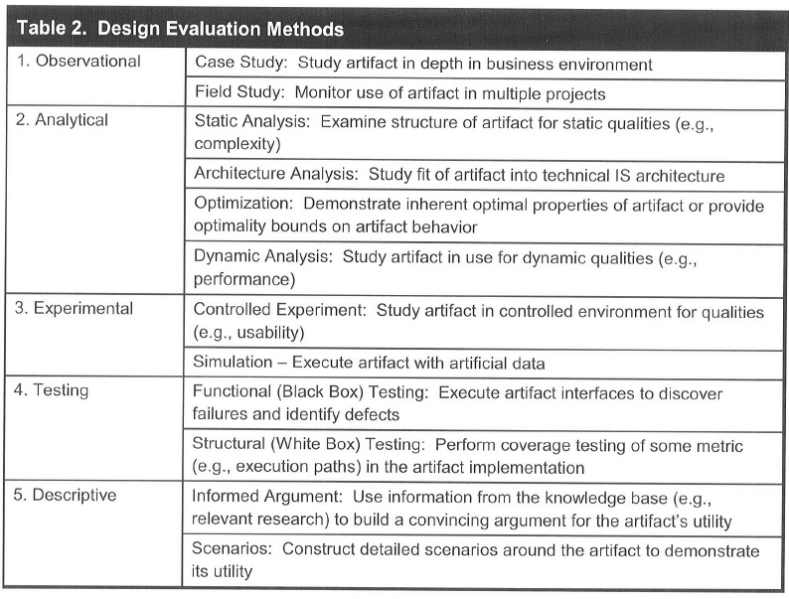
Diretriz 5 - Rigor na Demonstração
Fonte: Hevner et al (2004, p.86)

Slide 36
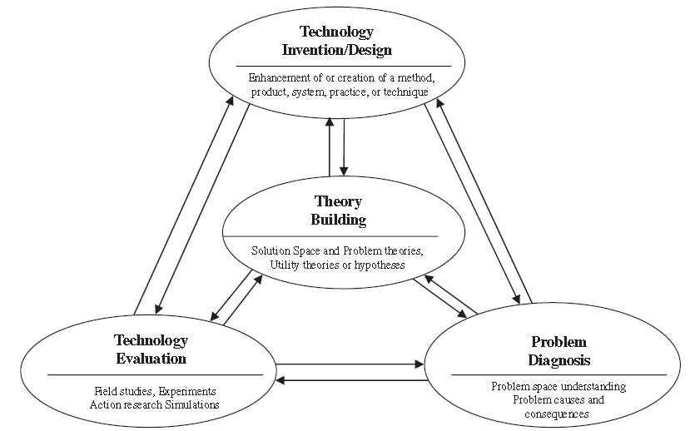
Framework de Atividades da Design Science
Fonte: Kuechler e Vaishnavi (2008, p.491)

Slide 37
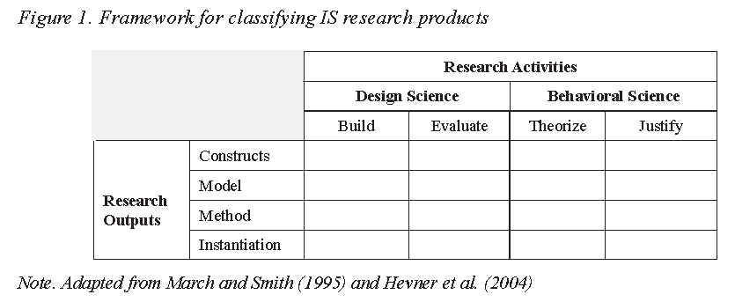
Framework de Atividades da Design Science
Fonte: Andoh-Baidoo (2007, p.68)
Atividades
Artefatos
(neste caso, da área de S.I.)

Slide 38
Exercício
Considere a adoção do ciclo da abordagem Design Science, conforme proposto por Van Aken e Romme (2009), para pesquisa que resultou o artigo “Análise da coesão entre seções de textos de documentos extensos a partir da aplicação conjunta das técnicas de análise de redes sociais e referências internas” (http://www.scielo.br/scielo.php?script=sci_arttext&pid=S1413-99362009000100011&lng=en&nrm=iso )
Quais seriam as principais diferenças em termos de redação e estruturação do artigo caso a abordagem Desing Science fosse aplicada à pesquisa em questão?

Slide 39
Voltada para Ciências Aplicadas (não hard science)
Design science research is not confined to engineering and medicine, but can be found in various other fields. Examples are computer science and information systems (e.g., March and Smith, 1995; Hevner et al. , 2004), accounting (e.g., Kasanen et al. , 1993; Labro and Tuomela, 2003) and education (e.g., Kelly, 2003; Barab and Squire, 2004; Collins et al. , 2004).
Fonte: Van Aken e Romme (2009, p.7)
Further relevant work appears in management (van Aken, 2004, 2005), management accounting (Kasanen et al., 1993), accounting information systems, (David et al., 2000), art (Owen, 1997), and education (Savelson et al., 2003; Kelly, 2003).
Fonte: Gregor e Jones (2007, p.318)
Simon (1996) asserts that design science research is the foundation of all professional disciplines.
Fonte: Simon (1996) apud Andoh-Baidoo (2007, p.66)

Slide 40
Não Confundir Design Science com …
What design science is not …
Design science is not design
Design science is not design theory
Design science is not an IT artifact
Design science is not methodology
Design science is not action research
Design science is not computer science
Design science is not a separate academic discipline
Design science is not new
The Design Research Society was founded in 1966. Simon’s book was first published in 1969.
Fonte: Baskerville (2008)

Slide 41
Referências
ANDOH-BAIDOO, F., et al. A Review of IS Research Activities and Outputs Using Pro Forma Abstracts. Information Resources Management Journal, v.4, n.20, p.65-79, Oct. 2007.
BASKERVILLE, R. What design science is not. European Journal of Information Systems, v.17, n.5, p.441-443, OCt. 2008.
GREGOR, S.; JONES, D. The Anatomy of a Design Theory. Journal of the Association for Information Systems, v.5, n.8, p.312-335, May 2007.
HEVNER, A.R. et al. Design science in Information Systems Research. MIS Quarterly, v.28, n.1, p.75-105, Mar 2004.
KUECHLER, B.; VAISHNAVI, V. On theory development in design science research: anatomy of a research project. European Journal of Information Systems, v.17, n.5, p.489-504 , Oct. 2008.
SIMON, H. The Sciences of the artificial . 3.ed. Cambridge, MA: MIT Press, 1996.
VAN AKEN, J.; ROMME, G. Reinventing the future: adding design science to the repertoire of organization and management studies. Organization Management Journal, v.6, n.1, p.2-12, Spring 2009.

